Slide 1
Software licensing
Professor : Rejaul Chowdhury
Email: chowdhr@algonquincollege.com
Office: T323

Slide 2
Objectives
Define and categorize the term software.
List the ways of obtaining a software.
Discuss whether a business organization build or buy a software.
Define the term open-source and identify its primary characteristics.
Access software and databases from the Internet via a web browser through cloud computing which is referred to as “Software as a service (SaaS)”.

Slide 3
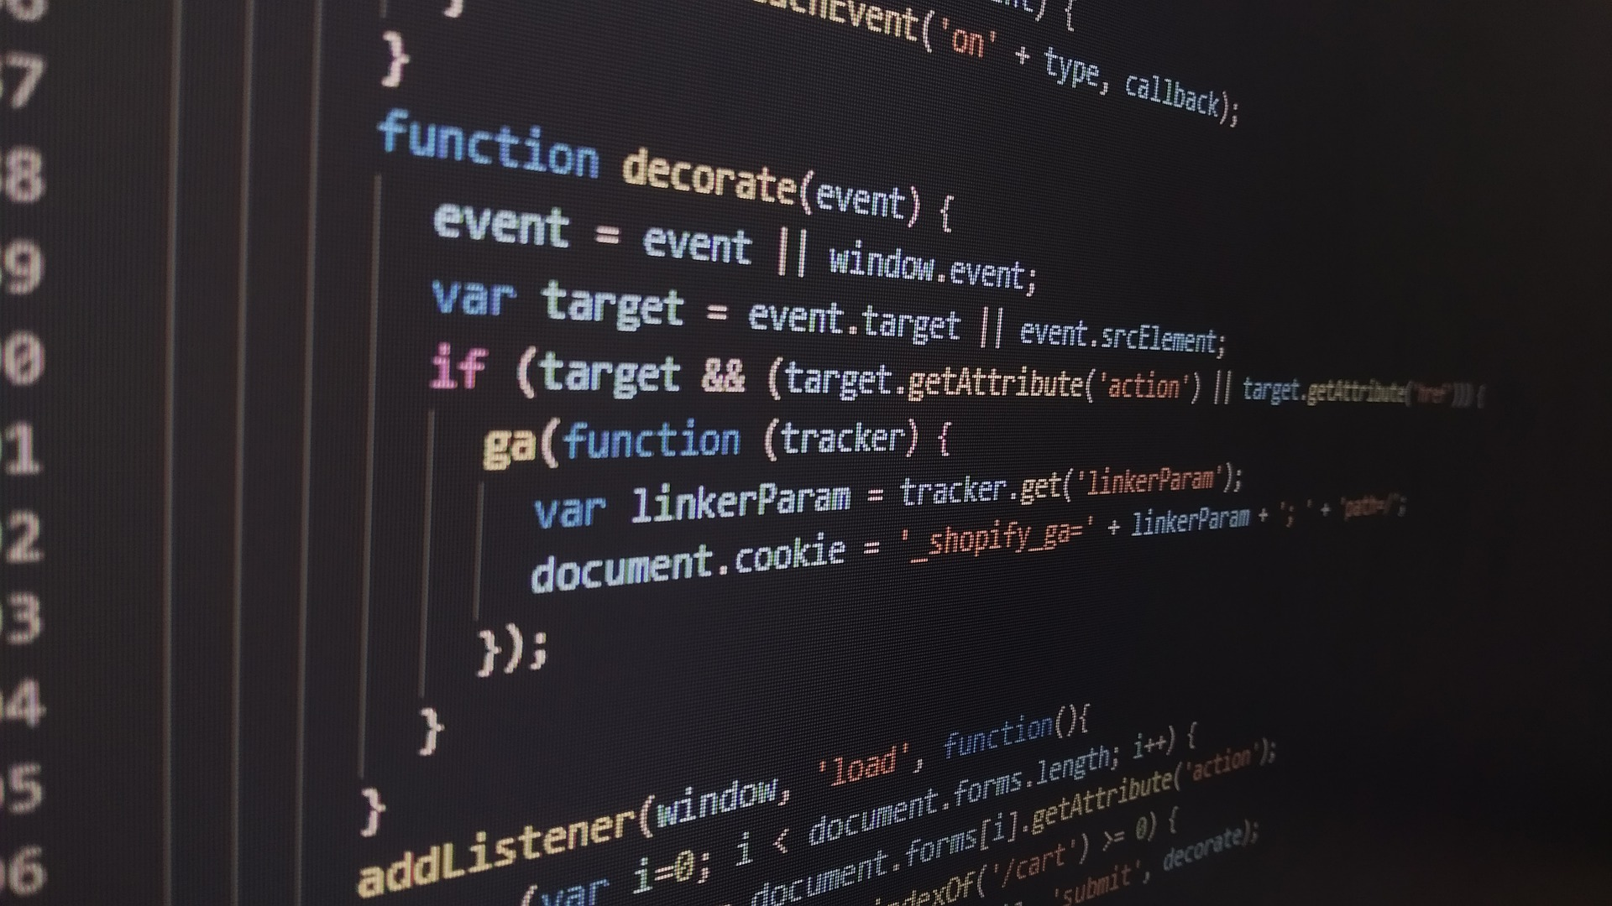
Software Programming
Programming is the process of creating a set of logical instructions for a digital device to follow using a programming language. The process of programming is sometimes called “coding” because the developer takes the design and encodes it into a programming language which then runs on the computer.
Notes:
A programming language is an artificial language that provides a way for a developer to create programming code to communicate logic in a format that can be executed by the computer hardware.

Slide 4
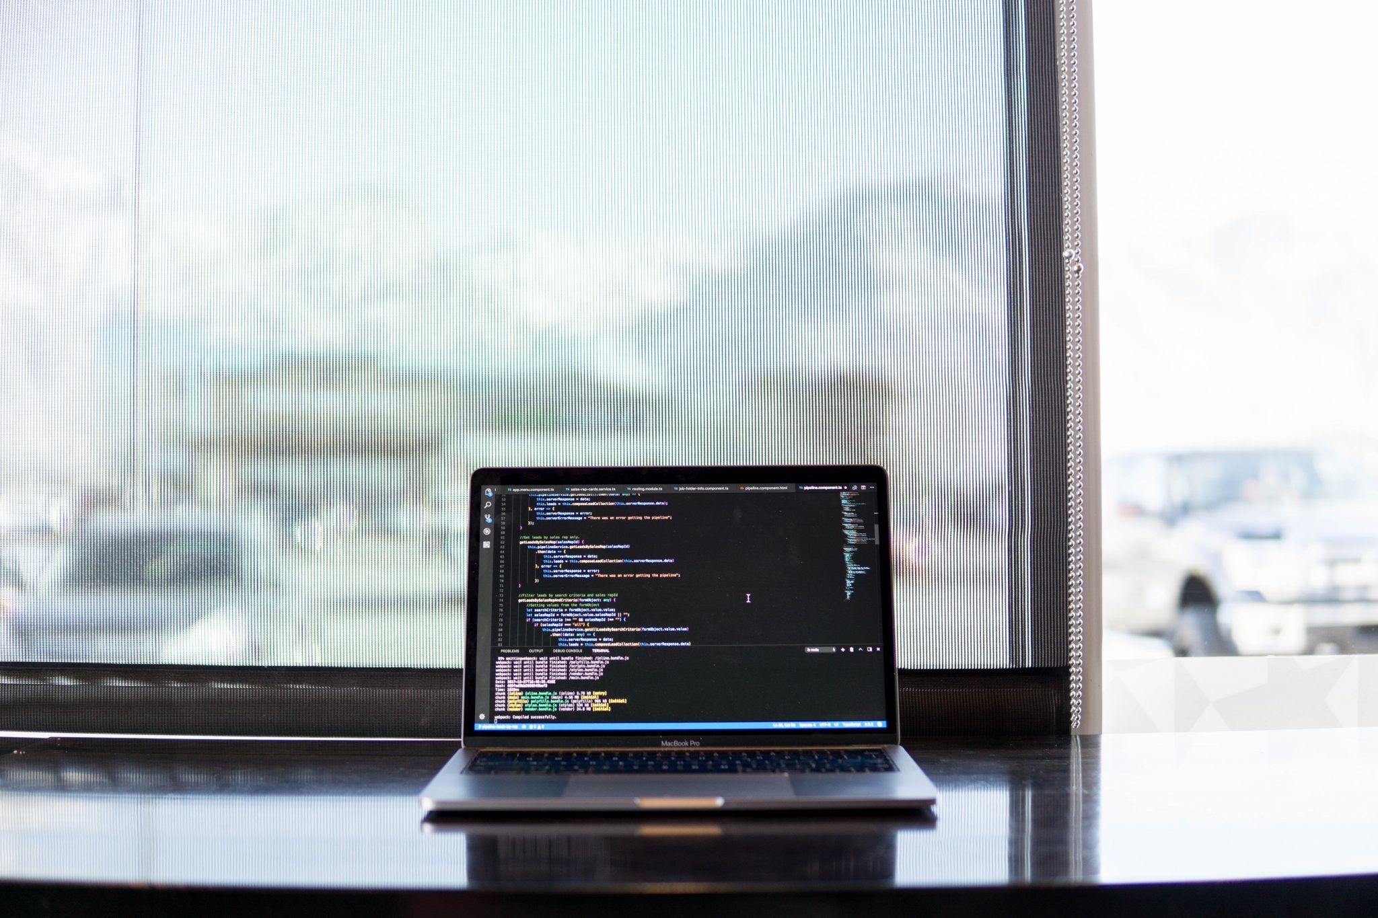
Software Introduction
Software can be broadly divided into two categories: Operating Systems and Application Software.

Slide 5
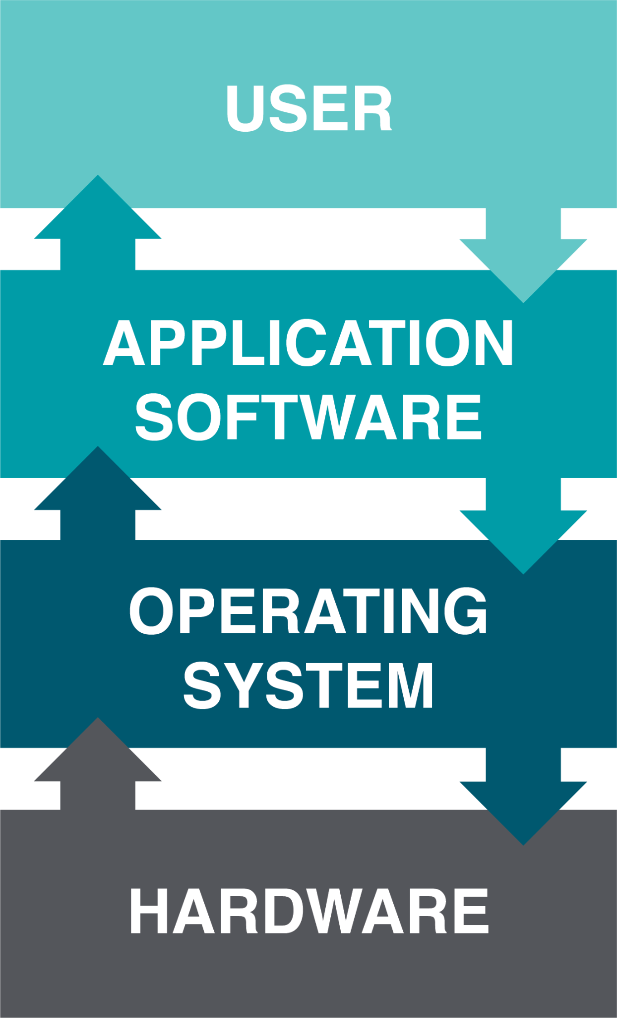
Operating Systems
Operating systems manage the hardware and create the interface between the hardware and the user.
Key functions:
Managing the hardware resources of the computer
Providing the user-interface components
Providing a platform for software developers to write applications.
Notes:
Operating systems are designed to create a platform so that programmers can write additional applications, allowing the computer to do even more useful things.
Important to know: All computing devices require an operating system.
The most popular operating systems for personal computers are: Microsoft Windows, Apple’s Mac OS, and various versions of Linux. Smartphones and tablets run operating systems as well, such as iOS (Apple), and Android (Google).

Slide 6
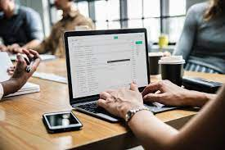
Application Software
Application Software is used to accomplish a specific goal such as word processing, calculations on a spreadsheet, or surfing the internet using a web browser.
What are some of the common types of application software that you use?
Notes:
There are many different types of application software, and they can work on mobile devices or desktop and laptop computers. Typically, software falls into the categories of productivity, multimedia, home, and communication and collaboration

Slide 7
Application Software Cont…
Productivity Software
Word processing
Users can create and edit documents using this class of software.
Spreadsheet
This class of software provides a way to do numeric calculations and analysis, displaying the result in charts and graphs.
Presentation
Users can create slideshow presentations using this class of software.
Notes:
There are many different types of application software, and they can work on mobile devices or desktop and laptop computers. Typically, software falls into the categories of productivity, multimedia, home, and communication and collaboration

Slide 8
Application Software Cont…
Productivity Software
Database management system
This software serves as an electronic filing cabinet for records such as customer lists, employee data, and inventory information. Data can be sorted, manipulated and queried to create reports.
Desktop publishing
This software combines word processing, graphics, and page layout software to create documents. Allows companies to design and produce sales brochures, catalogs, advertisements, and newsletters in-house.
Financial software
This software is used to compile accounting and financial data and create financial statements and reports.
Notes:
There are many different types of application software, and they can work on mobile devices or desktop and laptop computers. Typically, software falls into the categories of productivity, multimedia, home, and communication and collaboration

Slide 9

Desktop Software
Desktop software
applications installed on a personal computer—your browser, your Office suite, photo editors, and computer games are all desktop software.

Slide 10
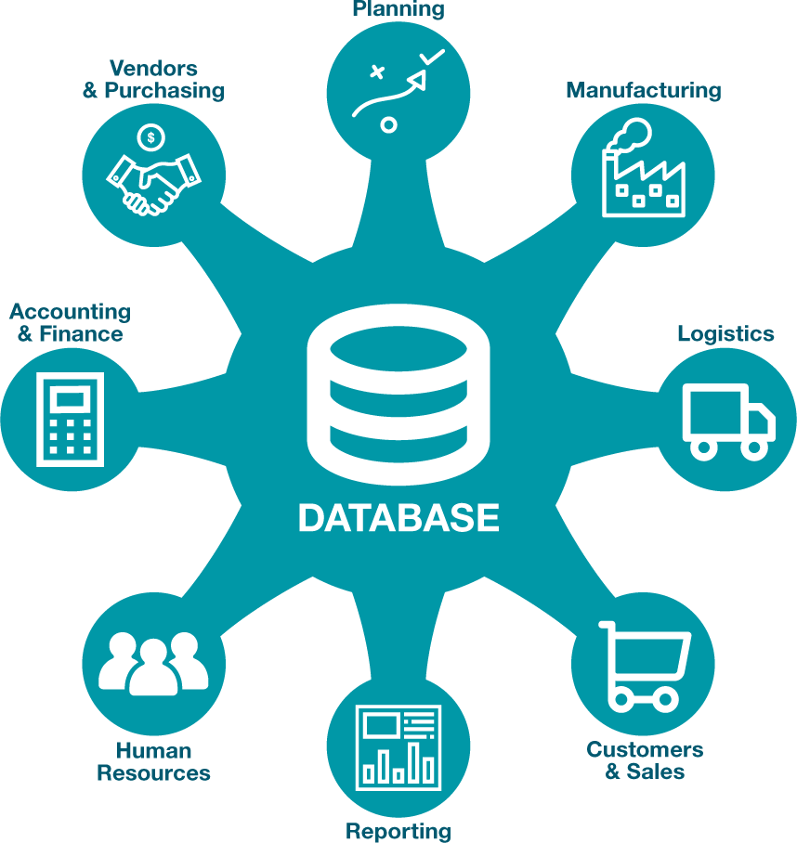
Enterprise Software
Enterprise software
applications that address the needs of multiple, simultaneous users in an organization or work group.
Enterprise resource planning (ERP)
software packages contain integrated modules that work together to bring the functions of an entire organization into one program.
Notes:
Most companies run various forms of enterprise software programs to keep track of their inventory, record sales, manage payments to suppliers, cut employee paychecks, and handle other functions.

Slide 11
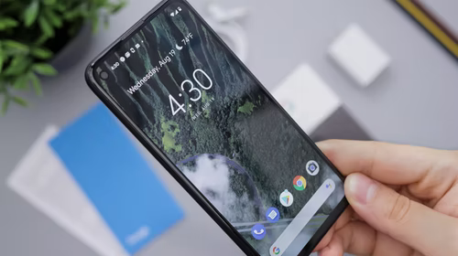
Mobile Software
Just as with the personal computer, mobile devices such as smartphones and tablets also have operating systems and application software. These mobile devices are in many ways just smaller versions of personal computers.
Notes:
A mobile app is a software application designed to run specifically on a mobile device.

Slide 12
Obtaining Software
Software can be obtained in a number of different ways.
It can be developed internally which is referred to as proprietary software.
It can be purchased off-the-shelf, also referred to as packaged software.
What are some of the advantages and disadvantages associated with each method?

Slide 13
Build Vs. Buy
When an organization decides that a new software program needs to be developed, they must determine if it makes more sense to build it themselves or to purchase it from an outside company. This is the “build vs. buy” decision.

Slide 14
Build Vs. Buy
Advantages
There are many advantages to purchasing software from an outside company.
First, it is generally less expensive to purchase software than to build it.
Second, when software is purchased, it is available much more quickly than if the package is built in-house.

Slide 15
Build Vs. Buy Cont.
Disadvantages
First, the same software you are using can be used by your competitors.
Second, if you purchase software from a vendor and then customize it, you will have to manage those customizations every time the vendor provides an upgrade.

Slide 16
Implementation And Maintenance
Once a new software is developed or purchased for a system, the organization must determine the best method for implementation. Convincing a group of people to learn and use a new system can be a very difficult process.
There are several different methodologies an organization can adopt to implement the software for a new system. Four of the most popular are:
Direct Cutover
Pilot Implementation
Parallel Operation
Phased Implementation

Slide 17
Open Source Software (1 of 3)
An alternative to traditional software development
Many users and coders can study, share, and modify the code
Program modifications must be shared with all people on the project and all licenses adhered to

Slide 18
Open Source Software (2 of 3)
Categorized open source communities into four community types
Ad hoc
Standardized
Organized
Commercial

Slide 19
Open Source Software (3 of 3)
Six different dimensions
General structure
Environment
Goals
Methods
User community
Licensing

Slide 20
Open Source Software
Advantages
The software is available for free
The software source-code is available; it can be examined and reviewed before it is installed.
The large community of programmers who work on open-source projects leads to quick bug-fixing and feature additions.
Disadvantages
Technical support from the company that developed the software.
Companies provide updates and features as required by the users.
Notes:
Open-source software makes the source code available for anyone to copy and use.
However, open-source software is also available in a compiled format that can be downloaded and installed. The open-source movement has led to the development of some of the most used software in the world such as the Firefox browser, the Linux operating system, and the Apache web server.

Slide 21

Cloud Computing
Through cloud computing applications, services, and data storage are made accessible through the internet.
Software as a service (SaaS) is software that is rented rather than purchased.
Notes:
Historically, an individual copy of the software had to be installed on the computer to use it.
Cloud service providers rely on giant server farms and massive storage devices that are connected via a network.

Slide 22
Key Takeaways
There are two basic categories of software: operating systems and applications.
Desktop applications are typically designed for a single user. Enterprise software supports multiple users in an organization or work group.
Cloud computing provides access to software and databases from the Internet via a web browser.
The software as a service (SaaS) category of cloud computing gives companies access to a large assortment of software packages without having to invest in hardware or install and maintain software on its own computers.

Slide 23
Key Takeaways
Software development is about solving business problems.
Developing new software applications requires several steps, from the formal SDLC process to more informal processes such as agile programming or lean methodologies.
In end-user computing, software development happens outside the information technology department.
Conducting a feasibility analysis is important to ensure the new system will be a good investment.

Slide 24
Key Takeaways
Programming languages have evolved from very low-level machine-specific languages to higher-level languages that allow a programmer to write software for a wide variety of machines.
Most programmers work with software development tools to make the software development more efficient.
Some companies choose to purchase software to save development costs and speed implementation.
When implementing new software applications, there are several different types of implementation methodologies that must be considered.

Slide 25
References
E-Commerce 2023: Business, Technology, Society, 17th edition
Kenneth C. Laudon
Business Essentials, 14th edition
Ronald J. Ebert
https://www.revenera.com/software-monetization/glossary/software-licensing

